Slide 3
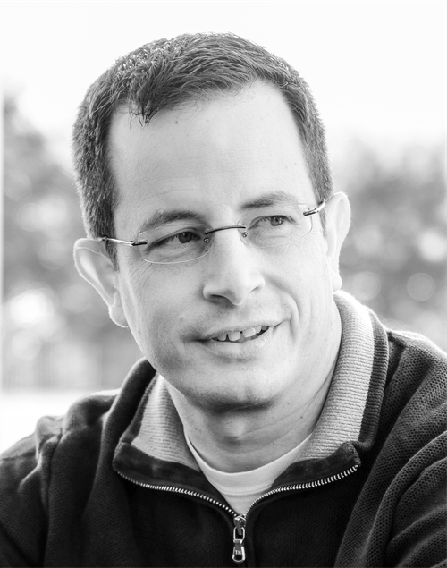
Nick Caruso
Entrepreneur & Consultant
ncaruso@gmail.com
(703) 581-8142
http://www.linkedin.com/in/ncaruso
The accompanying git repo is here:
https://github.com/njcaruso/bot-nodejs-demo

Slide 4






Agenda
Deployment & Wrap-up
Conversations
Natural Language Processing
YouTube Bot
Basic Bot
What’s a bot?
Notes:
00 - 05 - What’s a bot
05 - 15 - Build Basic Bot
15 - 25 – Build a YouTube Bot with Slack formatting output
25 - 35 - Deploy to Azure
35 - 45 – Natural Language Processing
45 - 55 – Conversations
55 – 60 – Wrap-up
60+ questions

Slide 5
Agenda
Deployment & Wrap-up
Conversations
Natural Language Processing
YouTube Bot
Basic Bot
What’s a bot?
Notes:
00 - 05 - What’s a bot
05 - 15 - Build Basic Bot
15 - 25 – Build a YouTube Bot with Slack formatting output
25 - 35 - Deploy to Azure
35 - 45 – Natural Language Processing
45 - 55 – Conversations
55 – 60 – Wrap-up
60+ questions

Slide 6
https://chatbotsmagazine.com/the-complete-beginner-s-guide-to-chatbots-8280b7b906ca#.4v0kntd4n
Hidden Slide
Much of the following is attributed to the below:

Slide 7
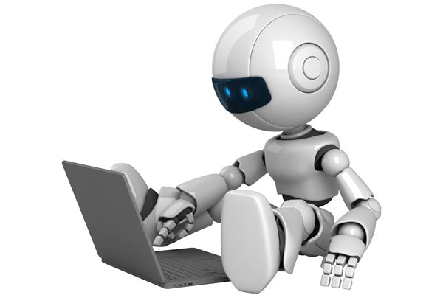
What’s a bot?
What’s a “Chatbot”?
Notes:
What’s a “BOT”?
A computer program that talks like a human.
A chatbot is a computer program designed to simulate conversation with human users, especially over the Internet.
chatbots often treat conversations like they're a game of tennis: talk, reply, talk, reply

Slide 8

Who is the most famous Chatbot?

Slide 9
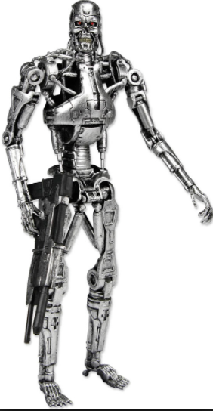
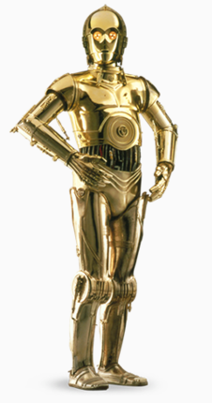
I suggest a new strategy,
Artoo: let the Wookie win
I’ll be back!

Slide 10
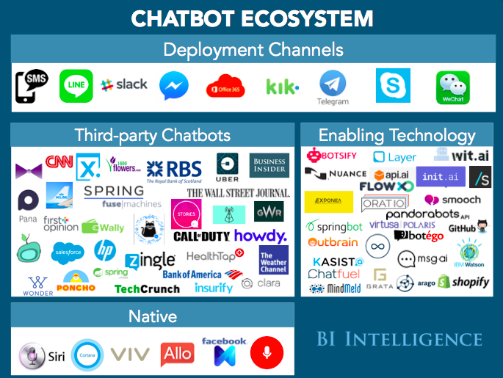

Slide 11
What’s a bot?

Slide 12
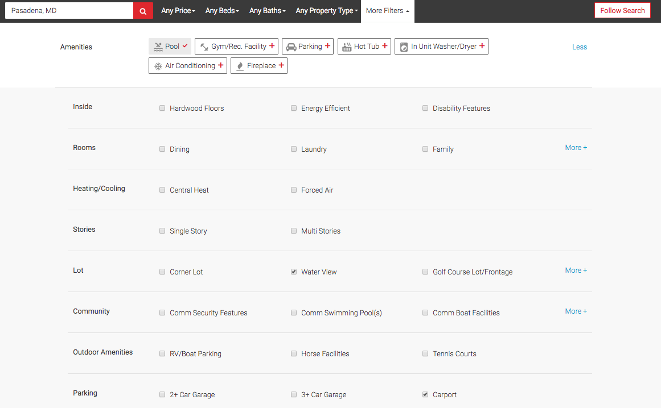
What’s a bot?
Looking to rent an apartment?

Slide 13
What’s a bot?
Complex form or chatbot?
“
I’m looking to rent a 2 bedroom apartment, with a pool and a nice water view. And I really want a carport.
”

Slide 14

What % of time on mobile devices is spent in either email or messaging platforms?
30%
60%
90%
Too
Much
Notes:
“~90% of our time on mobile is spent on email and messaging platforms. I would love to back teams that build stuff for places where the consumers hang out!”
— Niko Bonatsos, Managing Director at General Catalyst

Slide 15
What % of time on mobile devices is spent in either email or messaging platforms?
90%
30%
60%
Too
Much
Notes:
“~90% of our time on mobile is spent on email and messaging platforms. I would love to back teams that build stuff for places where the consumers hang out!”
— Niko Bonatsos, Managing Director at General Catalyst

Slide 16
What’s a bot?
Notes:
“People are now spending more time in messaging apps than in social media and that is a huge turning point. Messaging apps are the platforms of the future and bots will be how their users access all sorts of services.”
— Peter Rojas, Entrepreneur in Residence at Betaworks

Slide 17

How does it work?
What’s a bot?

Slide 18





What’s a bot?

Slide 19
Agenda
Deployment & Wrap-up
Conversations
Natural Language Processing
YouTube Bot
Basic Bot
What’s a bot?
Notes:
00 - 05 - What’s a bot
05 - 15 - Build Basic Bot
15 - 25 – Build a YouTube Bot with Slack formatting output
25 - 35 - Deploy to Azure
35 - 45 – Natural Language Processing
45 - 55 – Conversations
55 – 60 – Wrap-up
60+ questions

Slide 20
Basic Bot
“
”
Hi
“
”
Hello
“
”
Do you like cats?
“
”
Yes, I love cats!

Slide 21
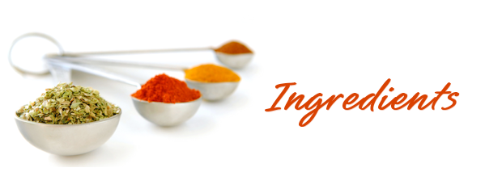


Basic Bot
Chat Platform
Some Complex Stuff
Programming Language
Deployment Platform

Slide 22
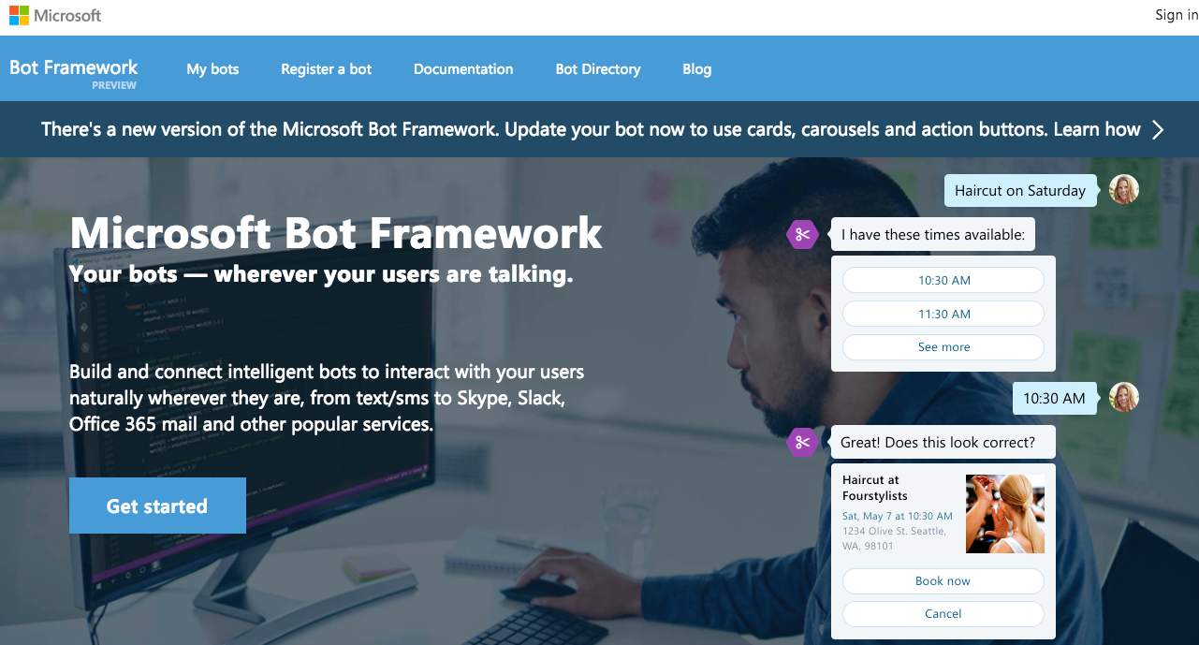
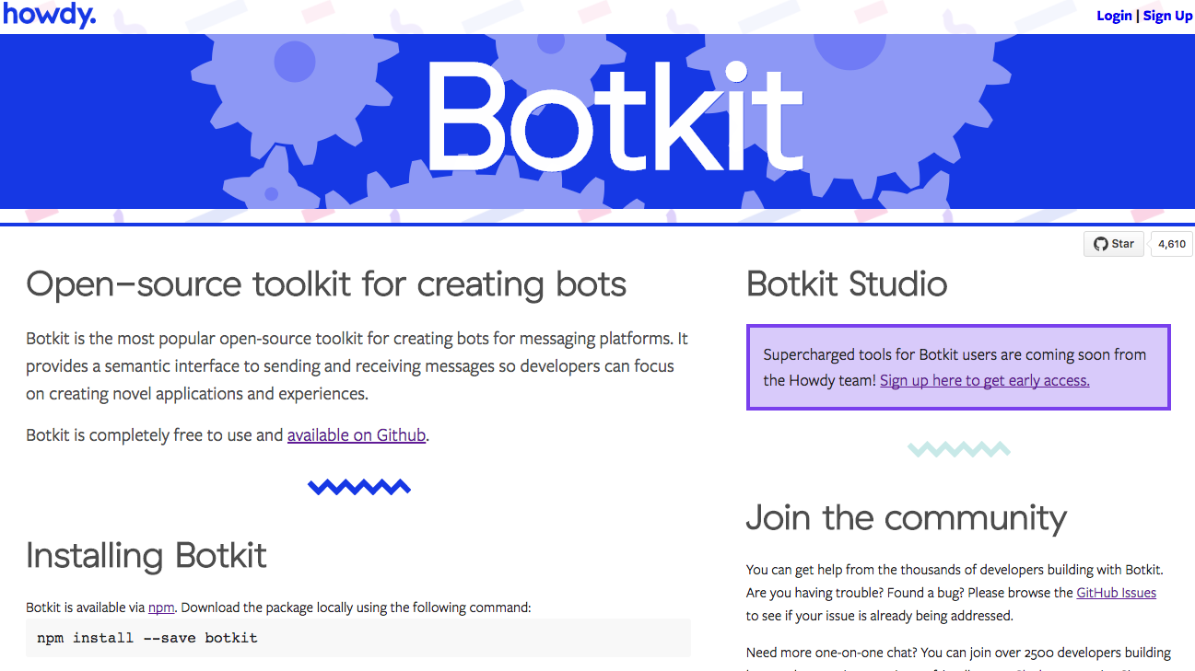
Basic Bot
Why not use a “kit” or “framework”?

Slide 23

Basic Bot
Chat Platform
Framework
Programming Language
Deployment Platform

Slide 24

Basic Bot
Coding Time!!!!!

Slide 25
Agenda
Deployment & Wrap-up
Conversations
Natural Language Processing
YouTube Bot
Basic Bot
What’s a bot?
Notes:
00 - 05 - What’s a bot
05 - 15 - Build Basic Bot
15 - 25 – Build a YouTube Bot with Slack formatting output
25 - 35 - Deploy to Azure
35 - 45 – Natural Language Processing
45 - 55 – Conversations
55 – 60 – Wrap-up
60+ questions

Slide 26
YouTube Bot
“
”
Search for videos about cats
“
”
Ok, I’ll search for videos about cats

Slide 27
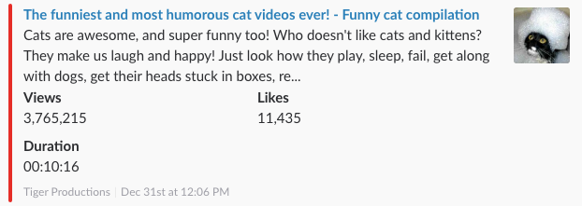
Clickable Title
Description
Thumbnail
Rockin’ Side Color
Short Stuff
Footer Stuff

Slide 28
Agenda
Deployment & Wrap-up
Conversations
Natural Language Processing
YouTube Bot
Basic Bot
What’s a bot?
Notes:
00 - 05 - What’s a bot
05 - 15 - Build Basic Bot
15 - 25 – Build a YouTube Bot with Slack formatting output
25 - 35 - Deploy to Azure
35 - 45 – Natural Language Processing
45 - 55 – Conversations
55 – 60 – Wrap-up
60+ questions

Slide 29
Natural Language Processing
“
”
Search for videos about cats
“
”
Search for YouTube videos about cats
“
”
Search for cat videos
“
Search for videos about cats but not lions
”
“
Search for videos about cats and kittens but not lions
”
“
Can you search for videos please about fixing my sink?
”
“
”
Find me some interesting videos regarding how to change my oil?

Slide 30
Natural Language Processing
And let’s say we want to add more fields
search term
language
duration
order

Slide 31
Natural Language Processing
“
Search for videos in French about Paris
”
“
”
Search for short funny videos
“
Search for short French videos about funny things in Paris
”
“
”
Search for short funny videos with the most views

Slide 32
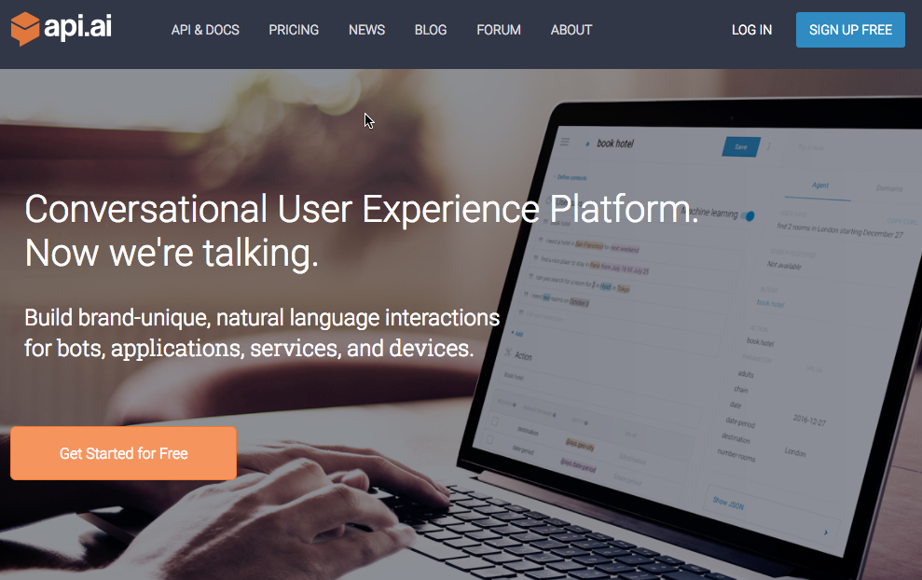
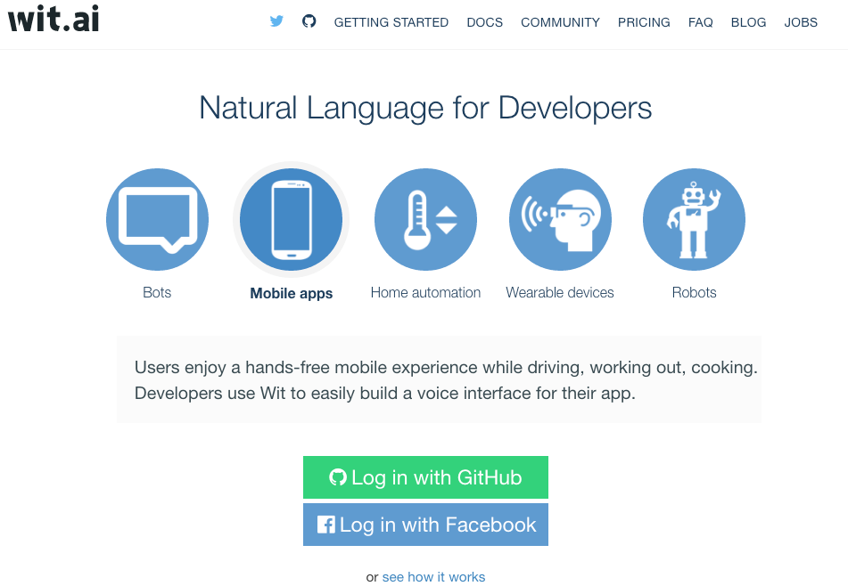
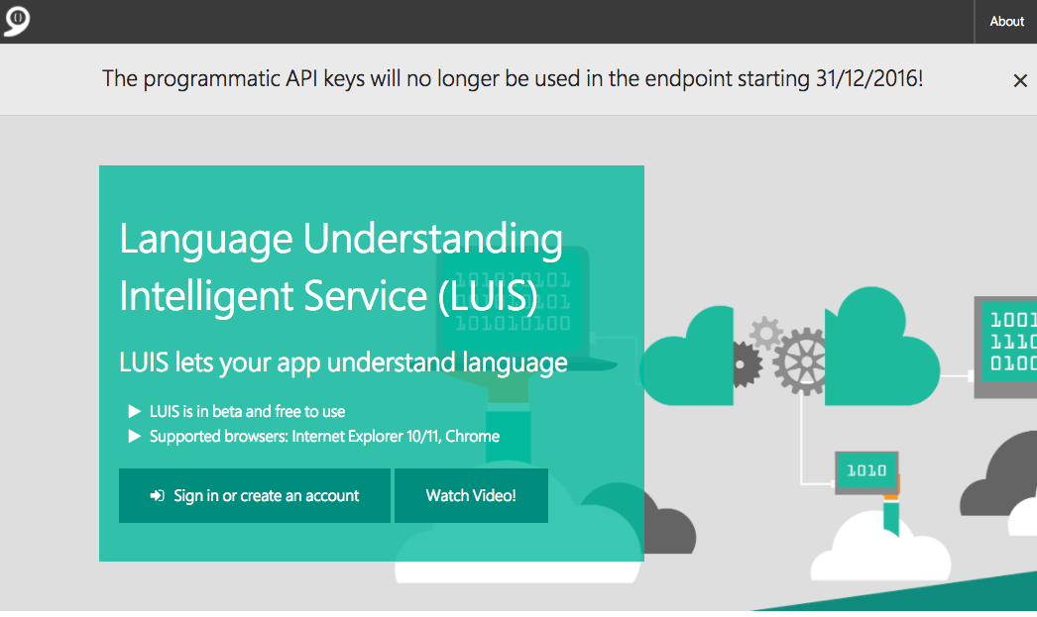
Natural Language Processing
api.ai = Google
wit.ai = Facebook
luis.ai = Microsoft

Slide 33
Agenda
Deployment & Wrap-up
Conversations
Natural Language Processing
YouTube Bot
Basic Bot
What’s a bot?
Notes:
00 - 05 - What’s a bot
05 - 15 - Build Basic Bot
15 - 25 – Build a YouTube Bot with Slack formatting output
25 - 35 - Deploy to Azure
35 - 45 – Natural Language Processing
45 - 55 – Conversations
55 – 60 – Wrap-up
60+ questions

Slide 34
Conversations
Let’s say we REQUIRE more fields
search term
language
duration

Slide 35
Conversations
“
”
Search for cat videos
“
”
Ok, how much time do you have?
“
Not much
”
“
”
Hmm, what order do you want to see (popularity, date, etc.)?
“
Most Viewed
”
“
Ok, I’ll search for the most viewed cat videos in English that
are just a few minutes long
”

Slide 36
Agenda
Deployment & Wrap-up
Conversations
Natural Language Processing
YouTube Bot
Basic Bot
What’s a bot?
Notes:
00 - 05 - What’s a bot
05 - 15 - Build Basic Bot
15 - 25 – Build a YouTube Bot with Slack formatting output
25 - 35 - Deploy to Azure
35 - 45 – Natural Language Processing
45 - 55 – Conversations
55 – 60 – Wrap-up
60+ questions

Slide 37


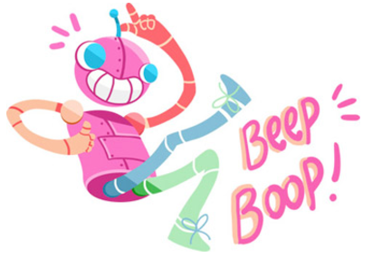

Deployment
Pick you PAAS
Notes:
Today's roboticists swear by Masahiro Mori's "uncanny valley" essay about creepy human imperfections that was published in an obscure Japanese journal called Energy more than 40 years ago.
used in reference to the phenomenon whereby a computer-generated figure or humanoid robot bearing a near-identical resemblance to a human being arouses a sense of unease or revulsion in the person viewing it.

Slide 38
Deployment
Pick you PAAS
Notes:
Today's roboticists swear by Masahiro Mori's "uncanny valley" essay about creepy human imperfections that was published in an obscure Japanese journal called Energy more than 40 years ago.
used in reference to the phenomenon whereby a computer-generated figure or humanoid robot bearing a near-identical resemblance to a human being arouses a sense of unease or revulsion in the person viewing it.

Slide 39
Wrap-up
Is your bot too scary?

Slide 40
Deployment
Masahiro Mori’s “uncanny valley”
Notes:
Today's roboticists swear by Masahiro Mori's "uncanny valley" essay about creepy human imperfections that was published in an obscure Japanese journal called Energy more than 40 years ago.
used in reference to the phenomenon whereby a computer-generated figure or humanoid robot bearing a near-identical resemblance to a human being arouses a sense of unease or revulsion in the person viewing it.

Slide 41
Wrap-up
Deployment & Wrap-up
Conversations
Natural Language Processing
YouTube Bot
Basic Bot
What’s a bot?
Notes:
00 - 05 - What’s a bot
05 - 15 - Build Basic Bot
15 - 25 – Build a YouTube Bot with Slack formatting output
25 - 35 - Deploy to Azure
35 - 45 – Natural Language Processing
45 - 55 – Conversations
55 – 60 – Wrap-up
60+ questions

Slide 42
Questions?

Slide 43
Nick Caruso
Entrepreneur & Consultant
ncaruso@gmail.com
(703) 581-8142
http://www.linkedin.com/in/ncaruso

Slide 44
Resources
wit.ai (bought by Facebook)
howdy’s botkit (raised $1.5+ mil in funding)
api.ai (raised $8.6+ mil in funding)
textit.in
Motion.ai
Chatfuel (Ycombinator company)
IBM’s Watson
BeepBoopHQ
Dexter (owned by Betaworks)
converse.ai
Gupshup

